Slide 1
INTRODUCTION
Manual disease detection in paddy crops is inefficient, subjective, and prone to errors, affecting yield and productivity.
A deep learning-based approach leveraging thermal imaging for precise and automated paddy leaf disease detection.
Utilizes ORB (Oriented FAST and Rotated BRIEF)keypoints for feature extraction and Grad-CAM for model interpretability, improving accuracy and transparency.
Deep Learning Models – Implements MobileNetV2, ResNet50, and for robust classification, enabling early disease diagnosis and timely intervention.

Slide 2
Abstract
Paddy leaf disease detection using deep learning trains neural networks on leaf images for accurate disease identification, enabling early detection and reducing crop losses. The ORB efficiently extracts key features, integrated with advanced DL models (ResNet50, and MobileNetV2) to enhance accuracy. Thermal imaging detects changes before symptoms appear, supporting proactive management. Grad-CAM visualization ensures interpretability, fostering trust in automated solutions. This approach advances AI-driven plant health monitoring, contributing to sustainable agriculture and improved crop management through efficient early disease detection.

Slide 3
Objectives
Accurate Identification of Paddy Diseases: Build a model that can identify and classify different paddy diseases early for better crop management.
Feature Extraction Using Filter-Based Transformation: Use techniques like edge detection and texture analysis to highlight disease signs such as spots and discoloration.
Scalability for Real-World Scenarios: Ensure the model works well in different conditions like changing light, noise, and leaf positions.
User-Friendly Implementation for Farmers: Make the system available through mobile apps or field devices for quick and easy disease detection.

Slide 4
Problem Statement
Paddy crops are susceptible to various diseases that impact yield, and traditional detection methods are often inaccurate and time-consuming.
Existing models for disease detection using thermal images face challenges such as low accuracy and poor generalization.
This project aims to develop a deep learning-based model for accurate and efficient detection of paddy leaf diseases using thermal images, addressing the limitations of current approaches.

Slide 5
Business Domain
Industry: Agriculture & Precision Farming
Application: Paddy Leaf Disease Detection, AI-Assisted Crop Monitoring
Impact: Enhances early disease detection, improves yield protection, and reduces manual inspection errors.
✅ Increased Accuracy & Early Intervention – Utilizes deep learning and thermal imaging for precise disease classification.
✅ Automated Monitoring & Reduced Labor – AI-driven detection minimizes manual effort, enabling farmers to take timely preventive measures.

Slide 6
Proposed Model
Uses Thermal Images – Captures heat variations to detect diseases early.
Feature Extraction – Implements ORB keypoints to enhance disease identification.
Deep Learning Models – Trains MobileNetV2, ResNet50 for classification.
Grad-CAM Integration – Provides visual interpretability of model decisions.
Improved Accuracy – Aims to outperform existing models with higher precision and recall.
Real-Time Deployment – Enables automated disease detection with alerts via mobile/web apps.

Slide 7
Dataset
The dataset contains thermal images of paddy leaves, categorized as healthy or diseased, enabling early disease detection.
Each image captures heat variations, allowing identification of plant stress before visible symptoms appear.
It is ideal for training deep learning models, improving accuracy using CNNs like MobileNetV2, ResNet50, and .
ORB keypoints and Grad-CAM enhance model interpretability, making disease detection more transparent.
Link 1: https://www.kaggle.com/datasets/sujaradha/thermal-images-diseased-healthy-leaves-paddy
Link 2: https://www.kaggle.com/datasets/ritikbompilwar/plantstressidentification

Slide 8
Methodology
Data Collection & Preprocessing
Feature Extraction : ORB for detecting keypoints
Deep Learning Model Implementation:Mobilenetv2, ResNet50 and Grad-CAM for visualization
Classification & Evaluation : Categorizing leaves as healthy / diseased and performance evaluation using precision, accuracy, recall, F1-score.
Model Deployment : Real time predictions, alerts farmers on disease risks.

Slide 9
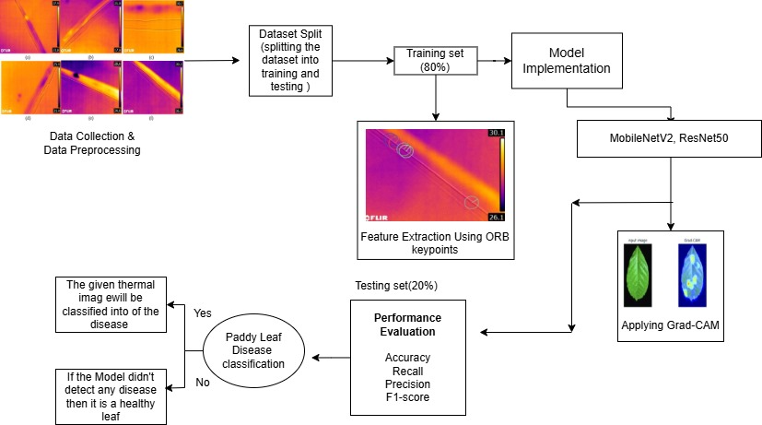
Workflow of Proposed Model

Slide 10
How the Model works?
1. Thermal Image Acquisition:
Thermal images of paddy leaves are captured using infrared cameras.
These images highlight temperature variations, which can indicate disease presence.
2. Preprocessing Steps:
Noise Reduction: Removes unwanted artifacts to improve image clarity.
Contrast Enhancement: Enhances temperature differences for better feature extraction.
Resizing & Normalization: Standardizes image size and scales pixel values for efficient processing.

Slide 11
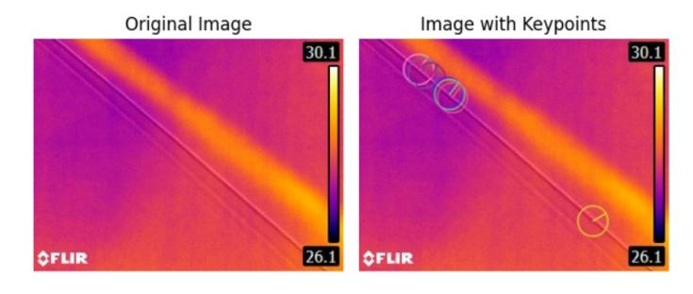
.
3. Dataset Splitting
The dataset is divided into Training (80%) and Testing (20%).
Training data is used to teach the model, while testing data evaluates its accuracy.
4. Feature Extraction Using ORB Keypoints
ORB (Oriented FAST and Rotated BRIEF) Algorithm is used to extract key features.
Detects important points in thermal images.
Helps in distinguishing diseased and healthy leaves based on texture and temperature variations.
Feature extraction reduces computational complexity and improves classification accuracy.
Detecting keypoints using ORB

Slide 12
.
5. Model Implementation
Two pre-trained deep learning models are used:
MobileNetV2 (Lightweight, efficient for mobile applications).
ResNet50 (Deep residual network, capable of detecting complex patterns).
The models are fine-tuned using the thermal dataset to learn disease-specific patterns.
The output layer classifies the images into Healthy or Diseased categories.
6. Applying Grad-CAM for Explainability
Grad-CAM (Gradient-weighted Class Activation Mapping) is used to interpret model predictions.
Highlights the areas in the image that the model focuses on while making a decision.
Helps verify that the model is correctly identifying diseased areas.

Slide 13
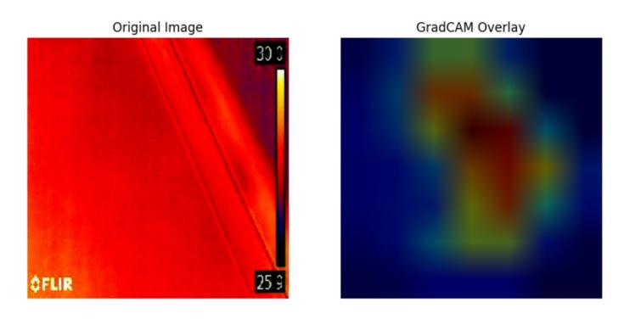
.
Gradcam Image
7. Paddy Leaf Disease Classification
The model analyzes the given thermal image and predicts one of two outcomes:
Diseased: If high-temperature variations indicate disease presence, the image is classified into a specific disease category.
Healthy: If no abnormal heat signature is detected, the leaf is classified as healthy.

Slide 14
.
8. Performance Evaluation
The trained model is tested on 20% of the dataset, and performance is evaluated using:
Accuracy → Measures overall correctness of the model.
Precision → How many predicted diseased leaves are actually diseased?
Recall → How well does the model detect actual diseased leaves?
F1-Score → Balances precision and recall for better evaluation.

Slide 15
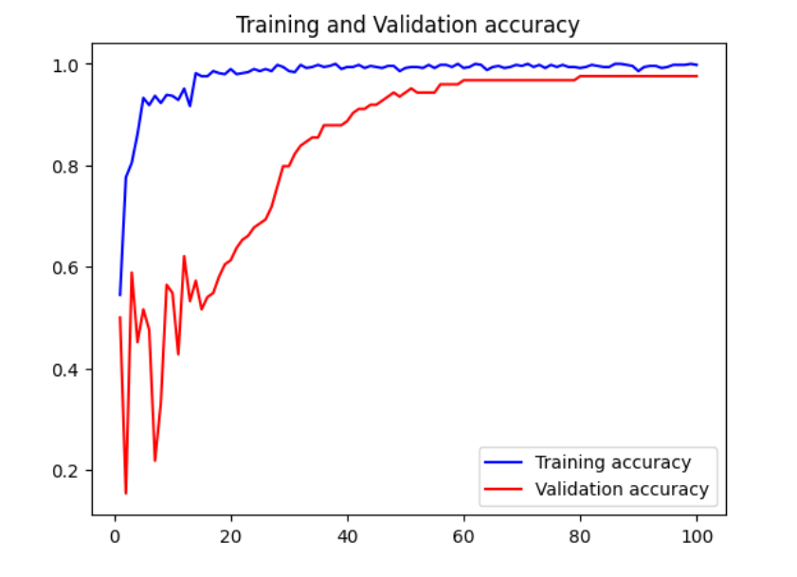
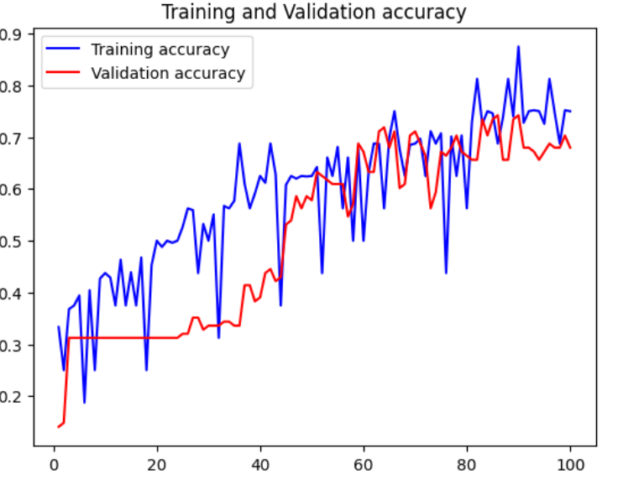
Results
MobileNetV2
ResNet50

Slide 16
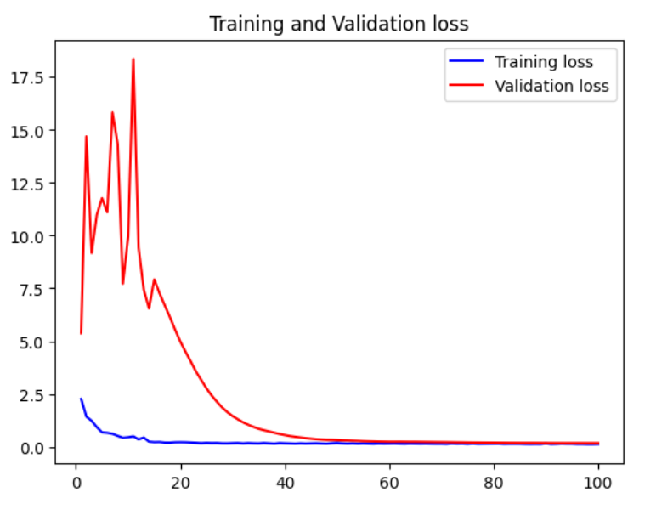
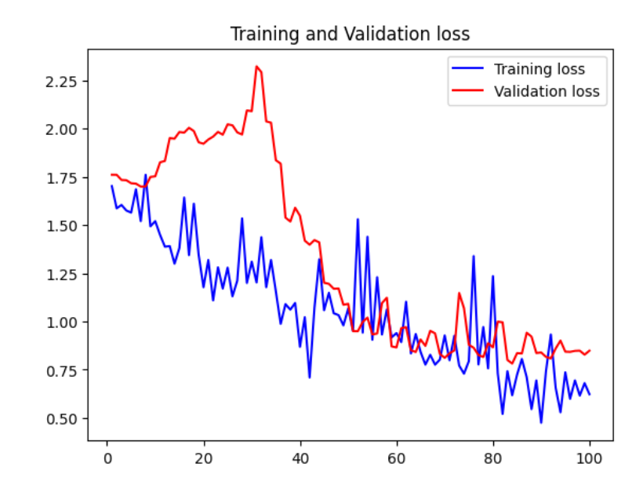
.
MobileNetV2 ResNet50

Slide 17
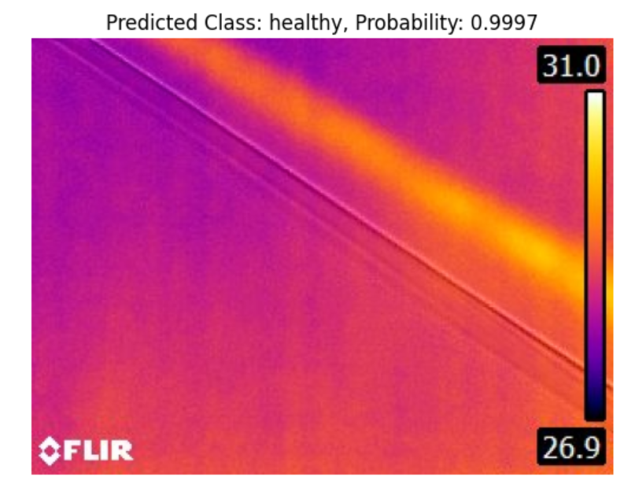
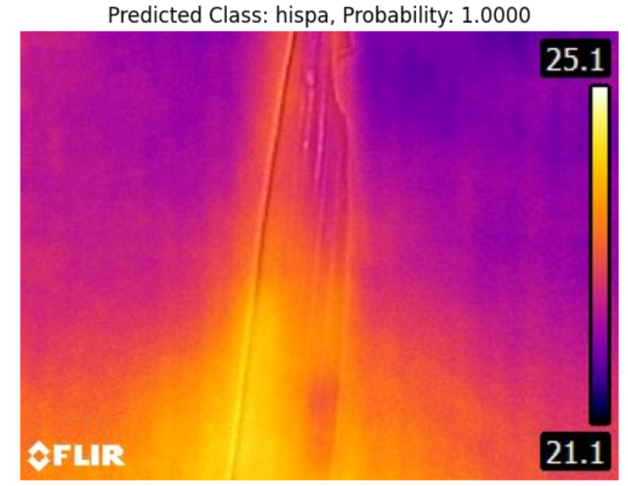
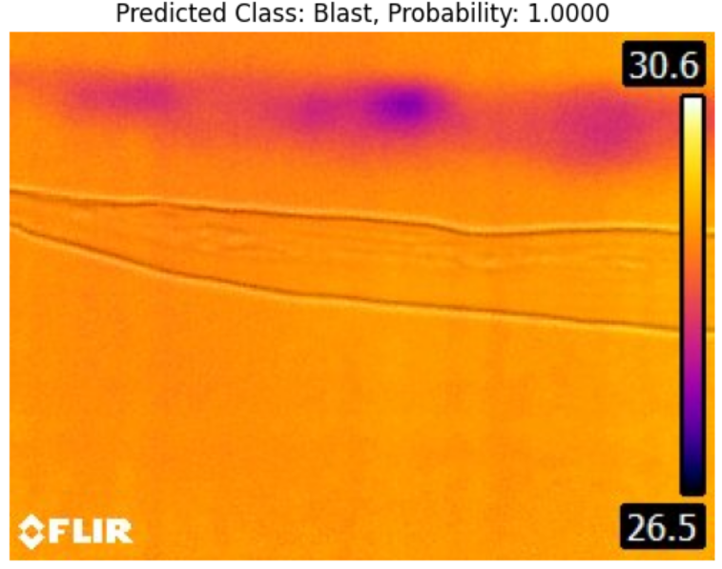
Diseases detected by MobileNetV2

Slide 18
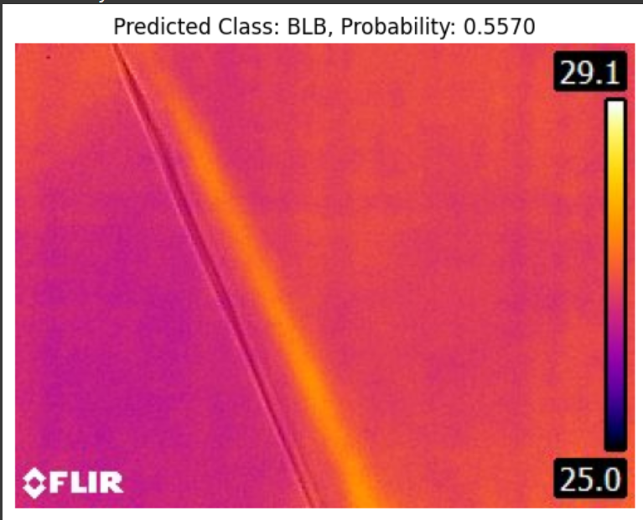
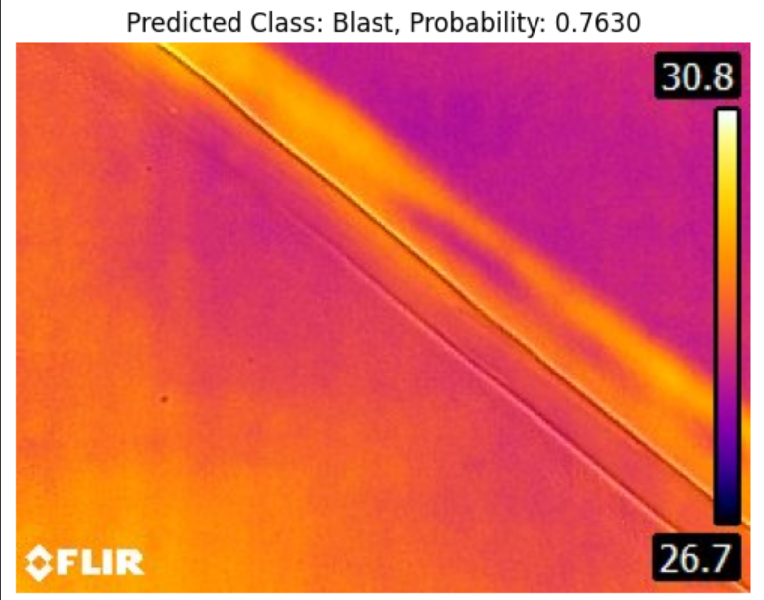
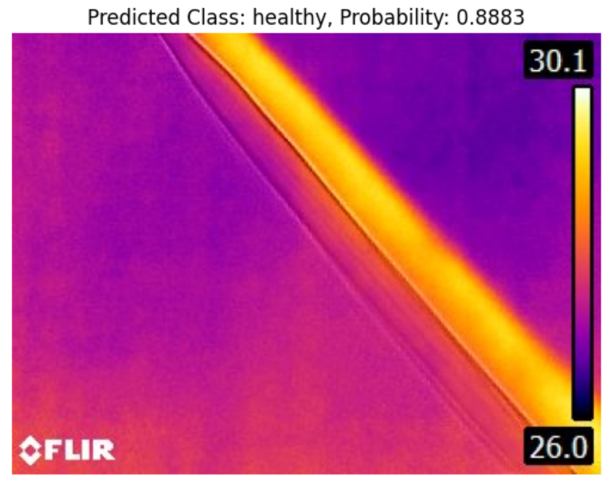
Diseases Detected by ResNet50

Slide 19
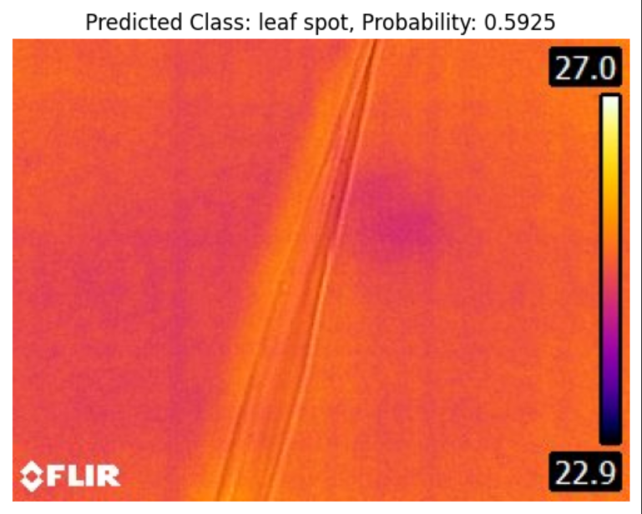
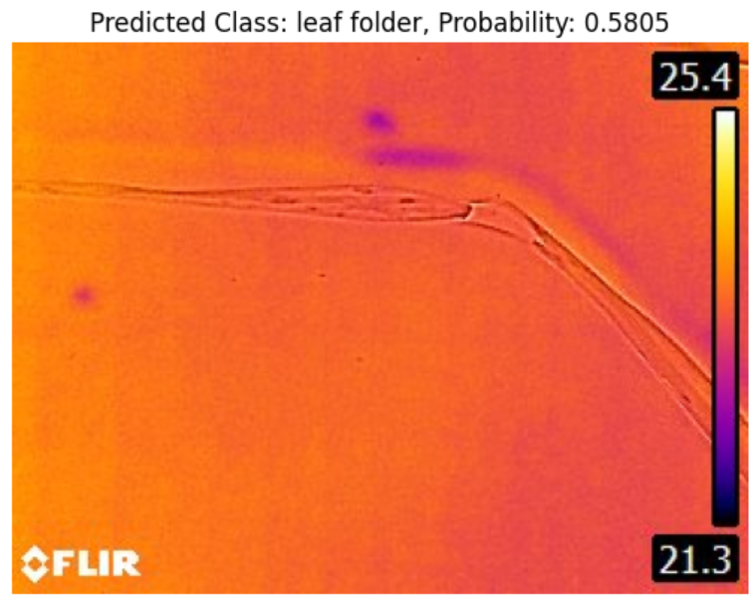
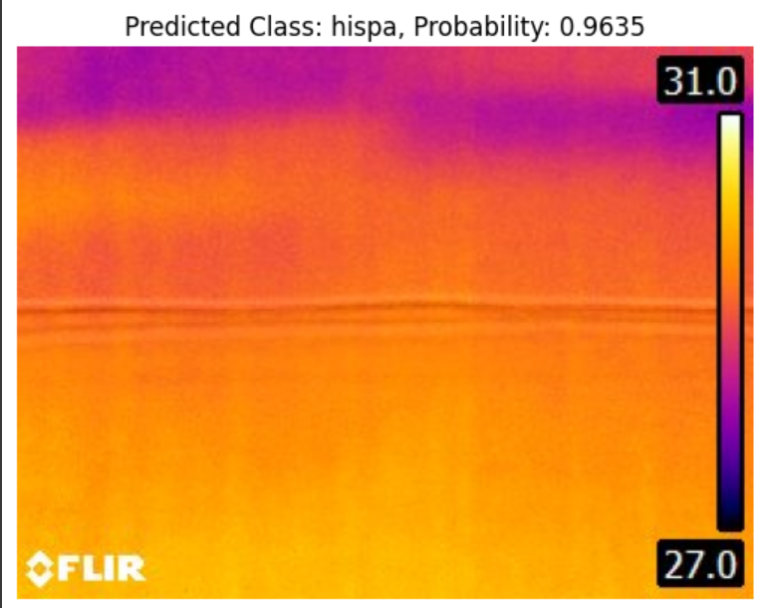
.

Slide 20
Performance Metrics
MobileNetV2
ResNet50
Accuracy – 97.58
Precision – 0.97
Recall – 0.97
F1-Score – 0.97
Accuracy – 67.97
Precision – 0.70
Recall – 0.68
F1-Score – 0.68

Slide 21
Why did this happen ?
MobileNetV2 is a lightweight model
It is designed to be fast and efficient.
It may have learned only the most common or easiest patterns.
This is why it correctly predicted only 4 diseases and ignored the rest.
ResNet50 is a deeper and more powerful model
It has more layers and can learn complex patterns.
Even though its accuracy is lower, it can recognise all diseases.
This means it tried to classify every disease, even if it made some mistakes.

Slide 22
Key Takeaways
Early Disease Detection – Utilizes thermal imaging and deep learning to detect plant diseases before visible symptoms appear, enabling timely intervention.
Advanced Feature Extraction – Implements ORB keypoints and Grad-CAM for improved disease identification and better model interpretability.
Deep Learning Model Integration – Leverages CNN architectures like MobileNetv2, ResNet50, and enhance classification accuracy.
Improved Accuracy & Performance – Overcomes limitations of traditional methods (KNN, RFC, LDA, HGBC) by achieving higher precision and reliability.
Boosts Detection Accuracy – By using deep learning models , the system identifies diseases more accurately and efficiently than traditional methods, helping farmers take action before crops are severely affected.

Slide 23
Future Scope
Early and Precise Detection: Combines ORB key points, Grad-CAM, and deep learning for early disease detection, even before visible symptoms, reducing crop losses.
Scalability: Can be scaled for large agricultural fields, eliminating manual inspections and saving time and costs.
Real-Time Insights: Integration with IoT devices or mobile apps provides real-time disease alerts and actionable recommendations.
Interpretable Results: Grad-CAM highlights affected regions on thermal images, making predictions interpretable and trustworthy.
Robustness: Thermal imaging and ORB ensure accurate detection in diverse conditions, overcoming the limitations of RGB models.

Slide 24
Thank you

